Slide 1
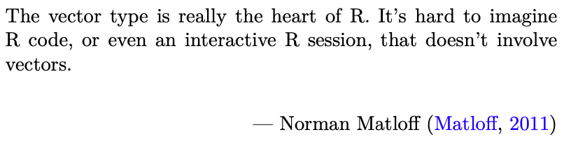
Data Science for Operational Researchers using R
02 – Atomic Vectors
https://github.com/JimDuggan/Data-Science-for-OR

Slide 2
Course Overview
Topic | Description
 | Morning 1
1 | Introduction to R and Posit Cloud
2 | Atomic Vectors
3 | Functions, Lists and Functionals
4 | Data Frames and Tibble
5 | ggplot2
 | Morning 2
6 | Data transformation with dplyr
7 | Relational Data with dplyr
8 | OR Example 1 – Exploratory Data Analysis
9 | OR Example 2 – System Dynamics

Slide 3
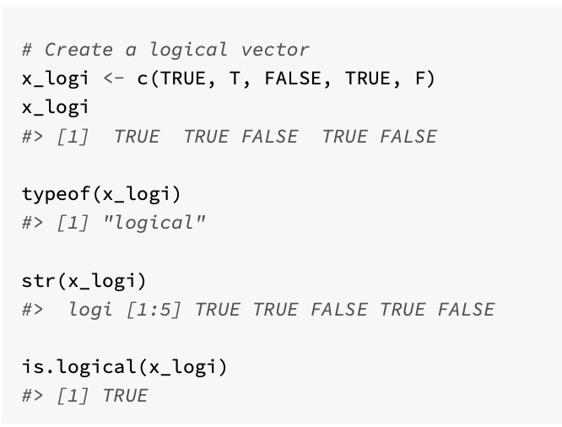
(1) Atomic Vectors
A one-dimensional data structure that allows you to store one or more values.
Created using the combine function c()
Assignment using ← operator (convention in R)
Four main types
logical
integer
numeric/double
character

Slide 4
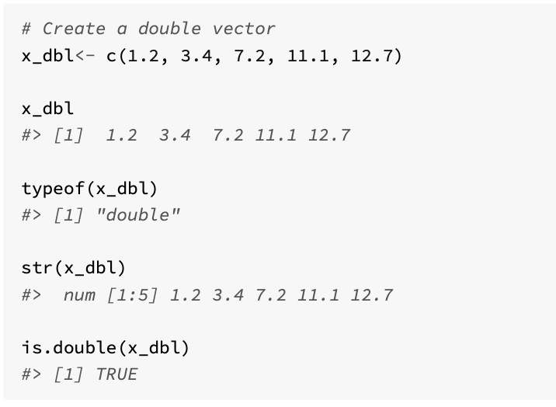
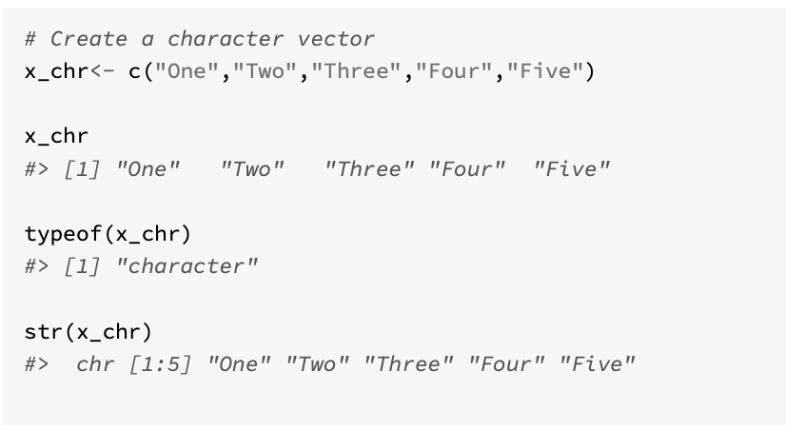
Other types

Slide 5
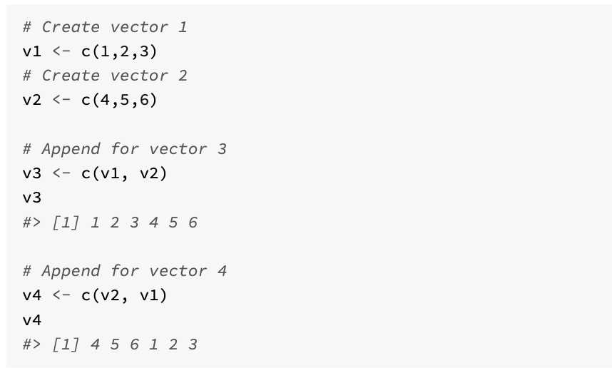
Combining Vectors

Slide 6
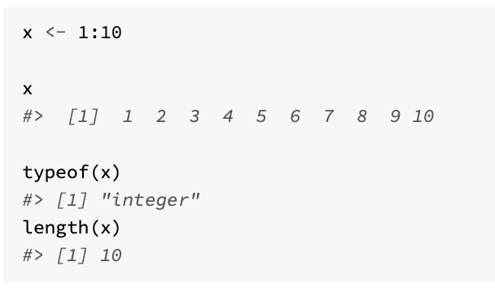
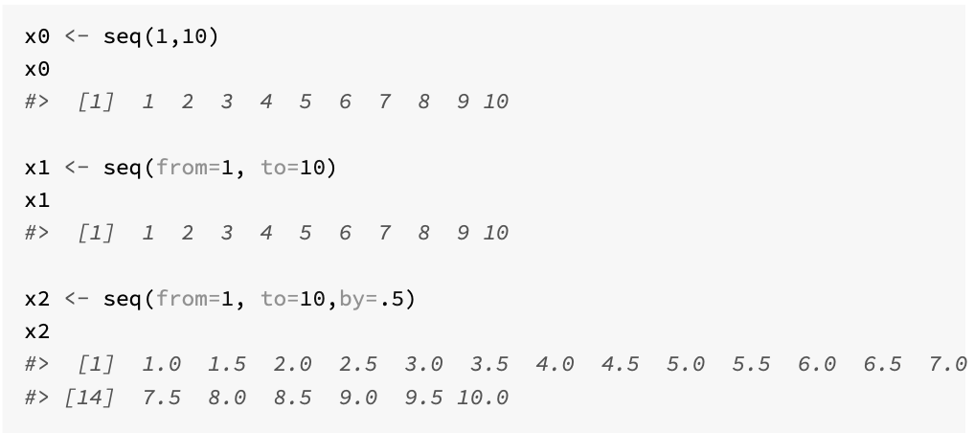
Creating large vectors
Colon operator :
seq() function
rep() function
vector() function

Slide 7
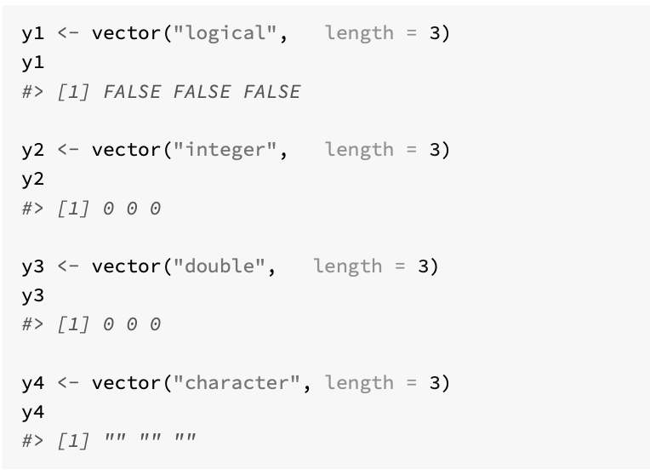
vector() function
Atomic vectors always contain data of the same type.
This is enforced by R using a process known as coercion.

Slide 8
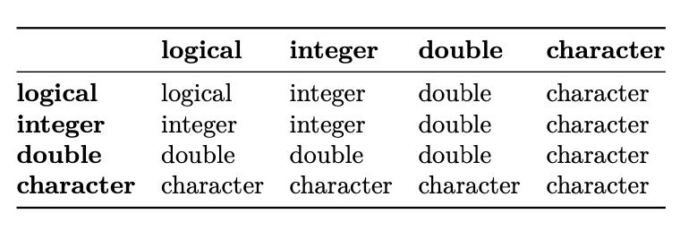
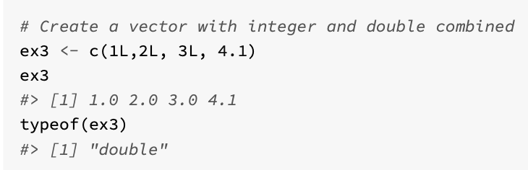
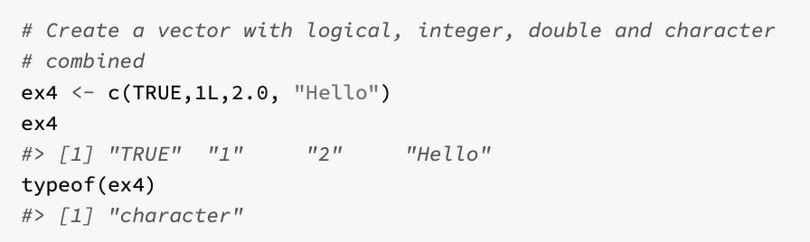
Coercion

Slide 9
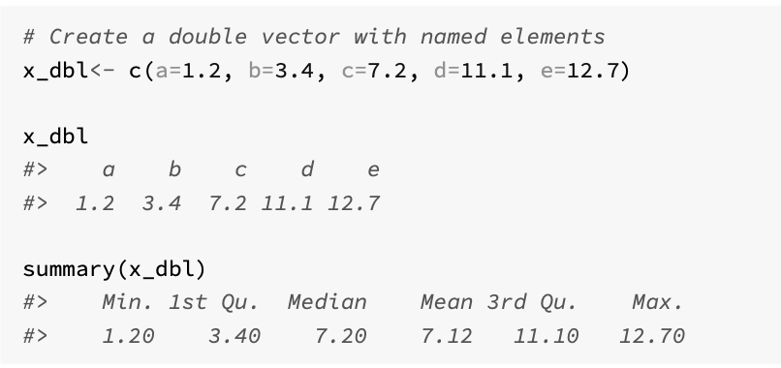
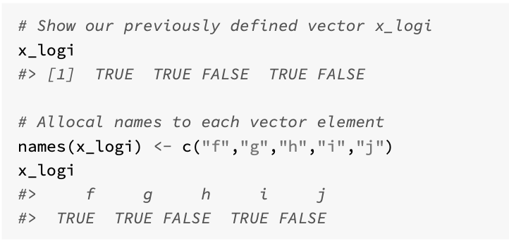
Naming vector elements (useful)

Slide 10
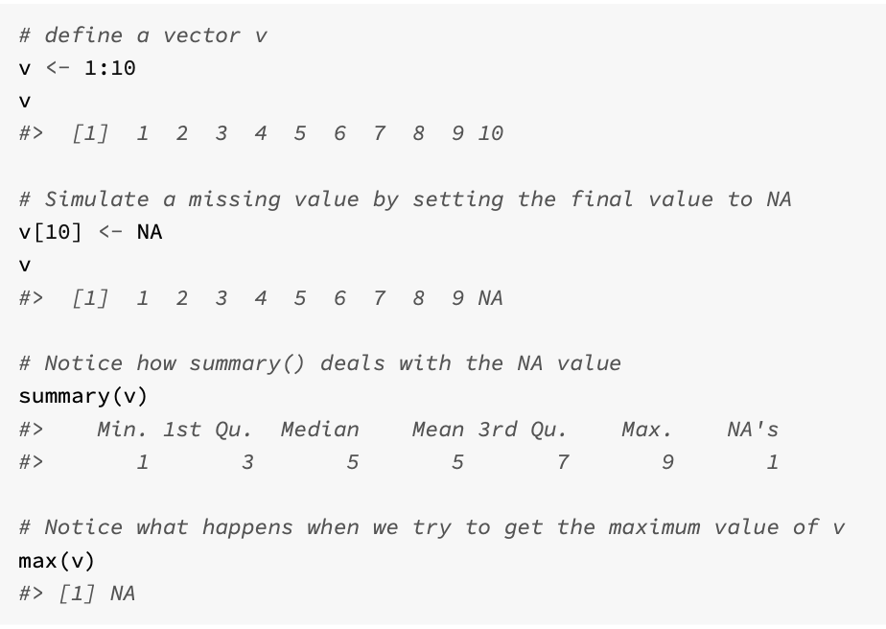
Missing Values
When analysing data, it is common that there will be missing values
A sensor (thermometer) might break down on any given day, and so an hourly temperature recording could be missed
Logical constant NA is used in R to record a missing value (“Not Available”)

Slide 11
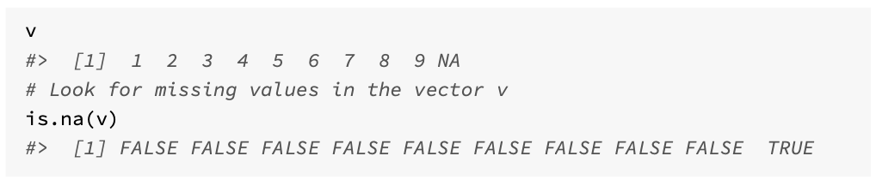
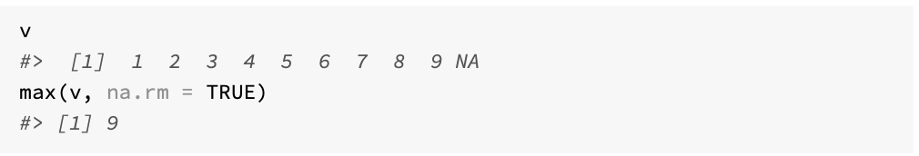
Detecting NAs

Slide 12
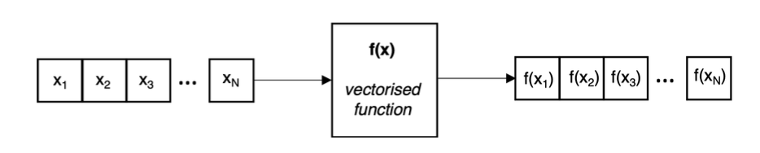
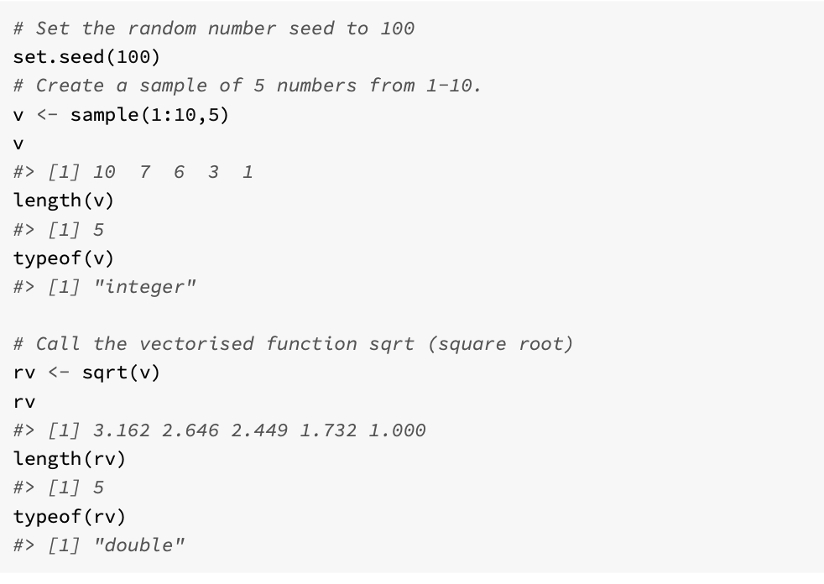
Vectorisation
Vectorisation is a powerful feature of R that where a function can operate on all the elements of an atomic vector, and return all the results in new atomic vector, of the same size.
In these scenarios, vectorisation removes the requirement to write loop structures that would iterate over the entire vector, and so leads to a simplified data analysis process.

Slide 13
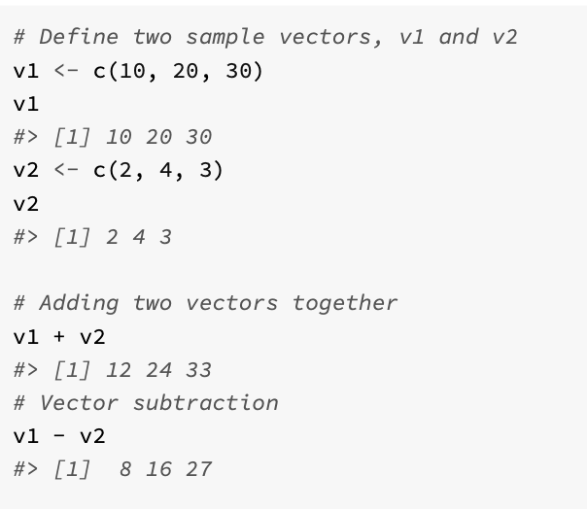
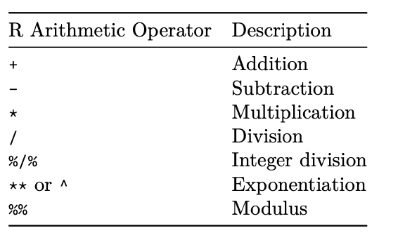
R Operators (Support vectorization)

Slide 14
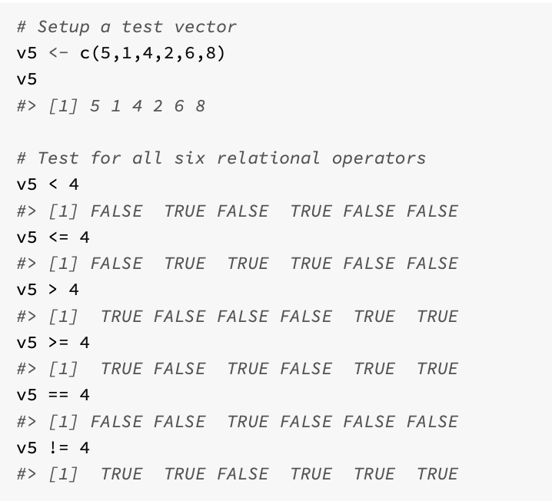
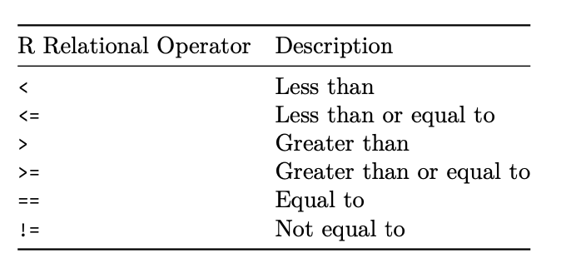
R Relational Operators (Support Vectoristion)

Slide 15
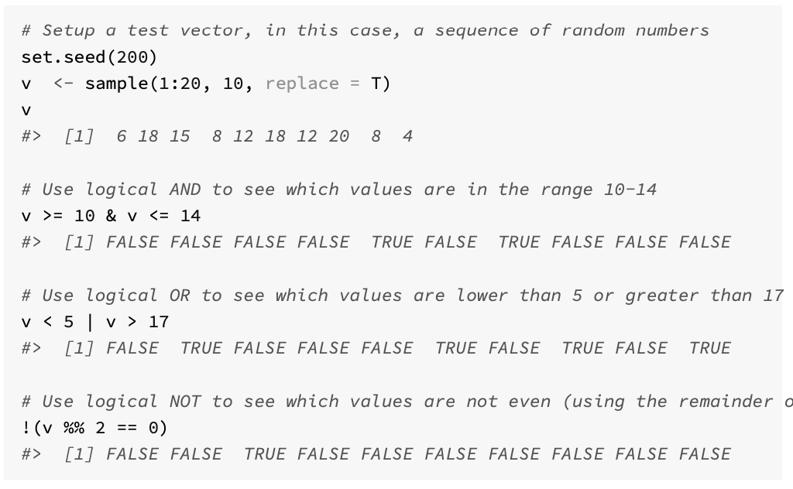
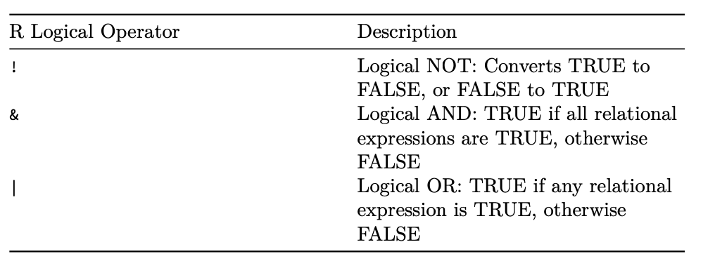
Logical Operators

Slide 16
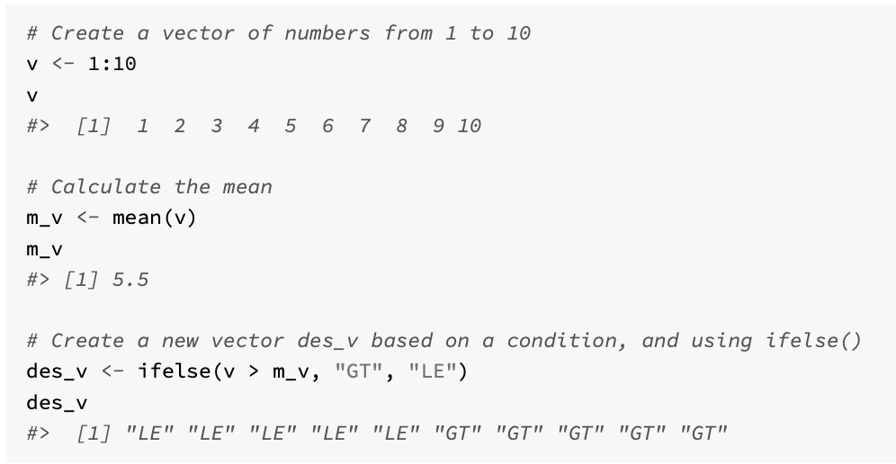
ifelse(test_condition, true_value, false_value)
test_condition is a logical vector, or an operation that yields a logical vector, such as a logical operator
true_value is the new vector value if the condition is true
false_value is the new vector value if the condition is false

Slide 17
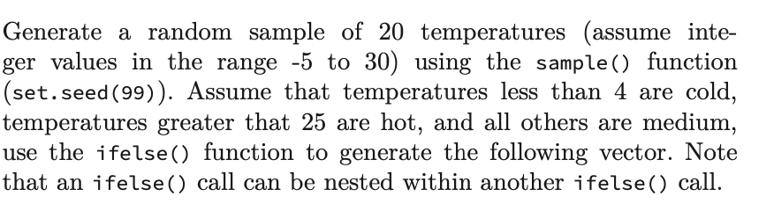
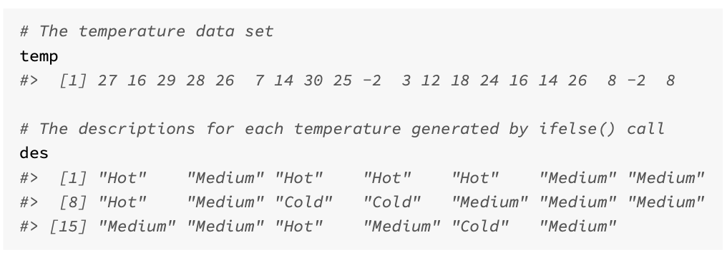
Challenge 2.1

Slide 18
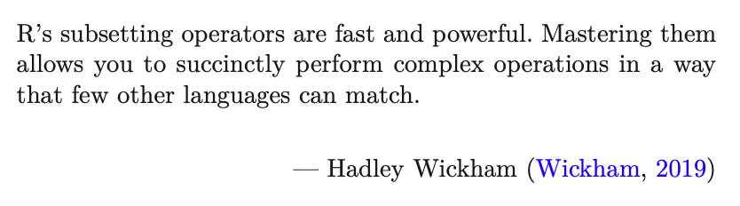
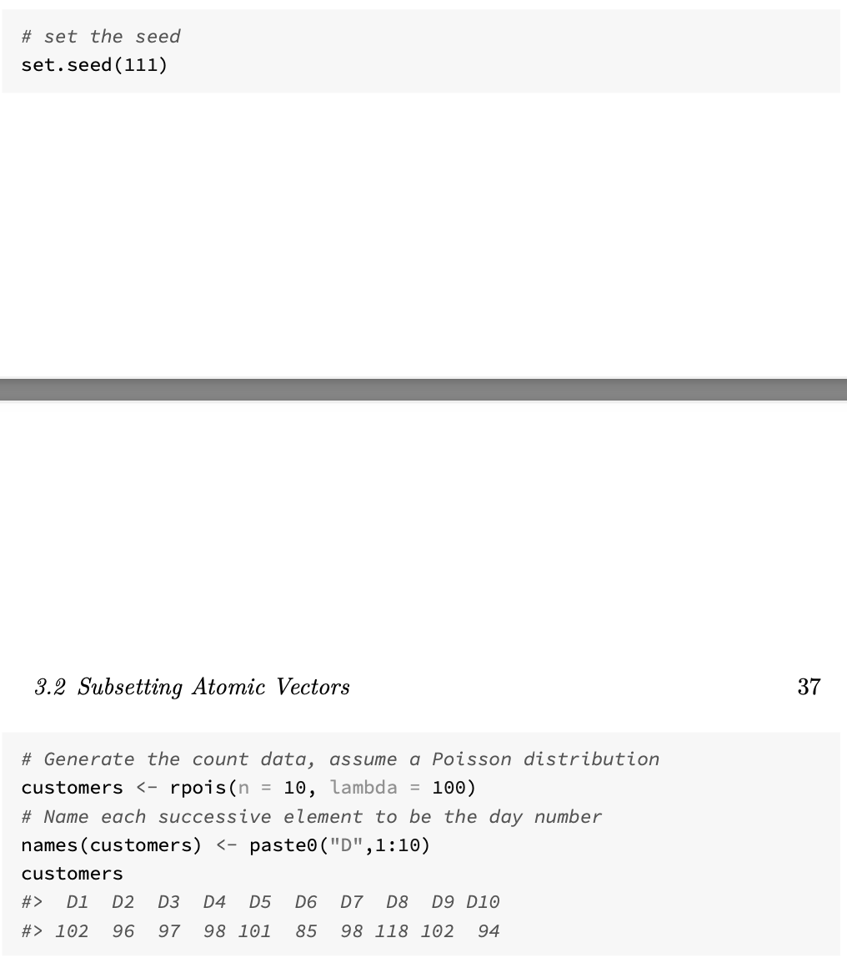
Subsetting
Subsetting operations allow you to process data stored in atomic vectors, and R provides a range of flexible approaches that can be used to subset data
There are 4 ways:
Positive integer
Negative integer
Logical vectors
Named elements

Slide 19
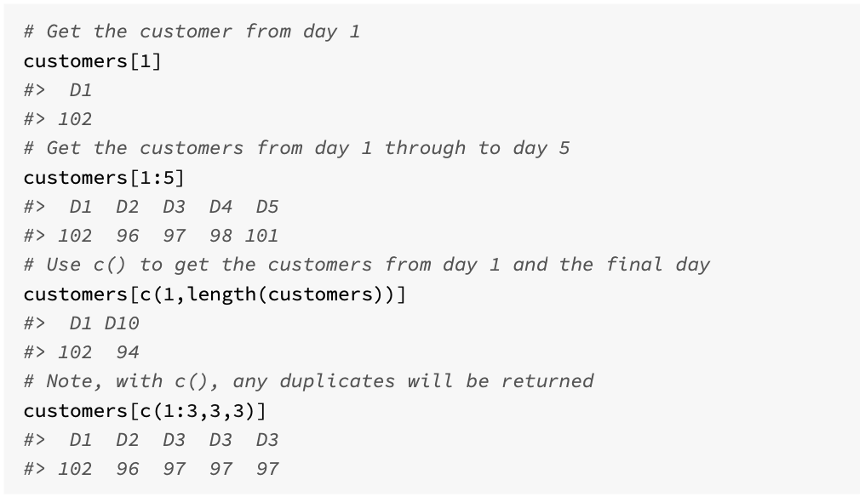
Positive integers

Slide 20
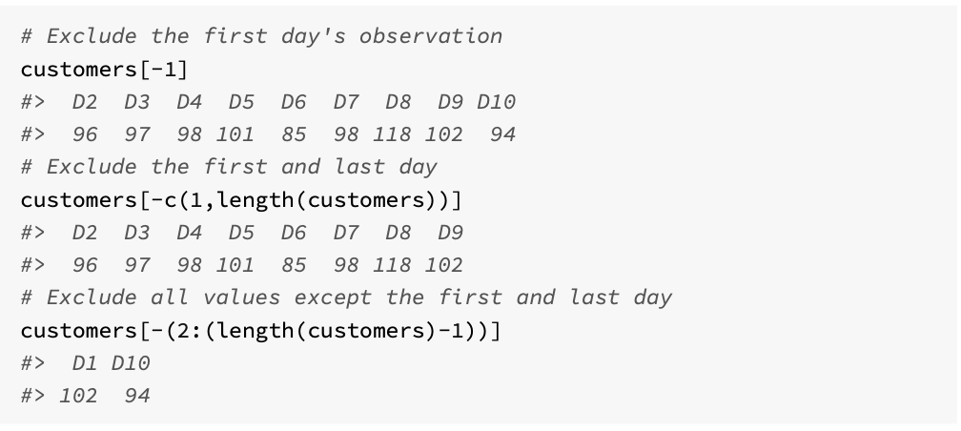
Negative integers (exclusion)

Slide 21
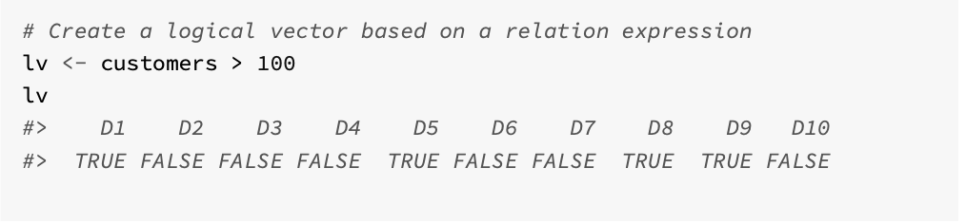
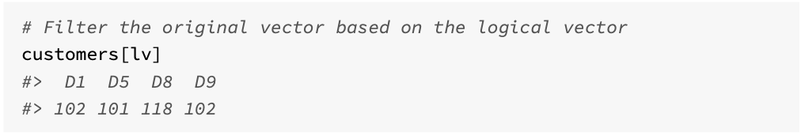
Logical vectors (1)

Slide 22
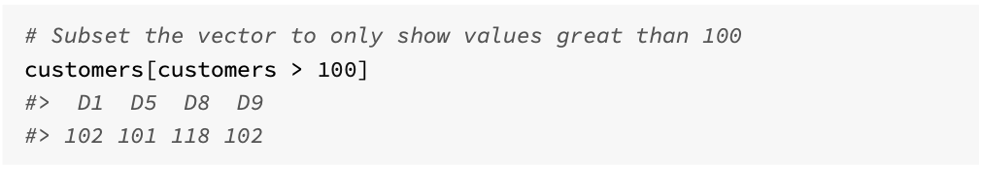
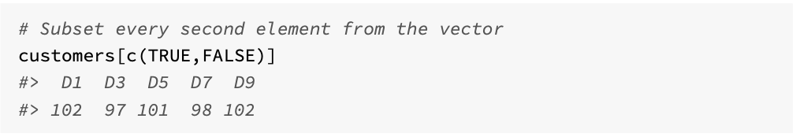
Logical vectors (2)

Slide 23
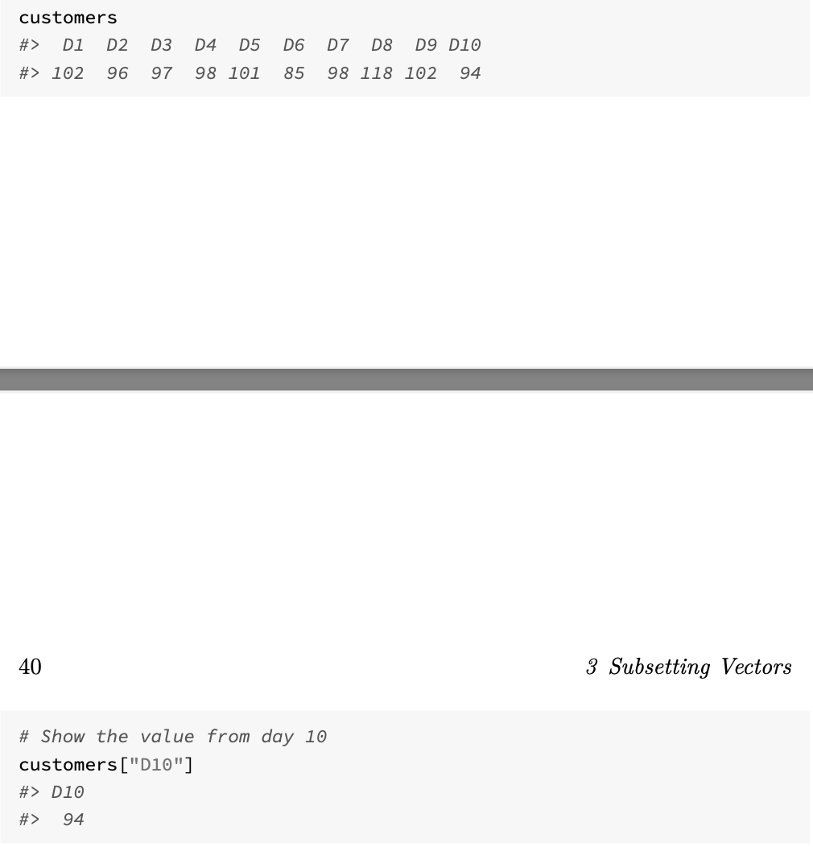
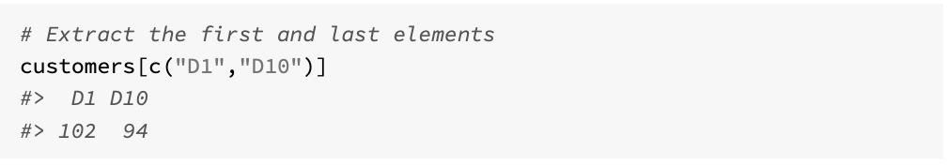
Named elements

Slide 24
Challenge 2.2
set.seed(100) to ensure everyone gets the same result
Use sample() to draw 1000 random numbers that represent a dice throw (dice 1)
Use sample() to draw another 1000 random numbers that represent a second dice throw (dice 2)
Add the outcomes together to simulate the throw of two dice
Use atomic vector subsetting to find the total number equal to 7
See how useful the function table() when applied to the sum of outcomes.

